Slide 1
Russian Peasant Multiplication
Decrease by constant method
[ Marawan Ayman 224341 ]

Slide 2
Problem definition
The Russian peasant multiplication method can accurately calculate the product of two given non-negative integers. It also leads to very fast hardware implementation since doubling and halving of binary numbers can be performed using shifts, which are among the most basic operations at the machine level.

Slide 3
Strategy
The approach we are going to use is “decrease by constant” method, as the Russian peasant multiplication method relies on repeated doubling and halving. By cleverly incorporating the decrease by a constant method, the Russian peasant multiplication method provides a remarkably efficient and elegant way to perform multiplication without complex calculations or requiring large memory space.

Slide 4
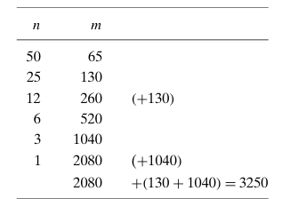
Explaining how to solve

Slide 5
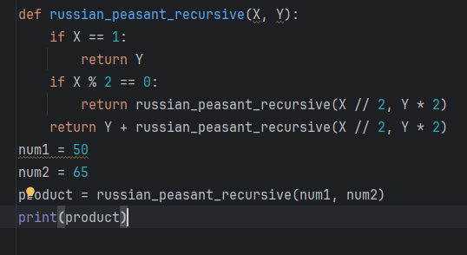
Implementation: (using Python)

Slide 6
Implementation (Cont.)
Lets say we want to multiply firstnumber(X) and secondnumber(Y)
The base case: when X becomes 1, the function returns Y
Recursive calls:
If X is even, we halve X and double Y, then the function calls itself with the new numbers.
If X is odd, we halve X and double Y, then we add Y to the result of a new recursive call with the new numbers.

Slide 7
Analysis
Suppose we want to multiply A and B.
T(A) = T(A/2)+1, T(1)=0
T(A/2) = [T(A/2^2)+1]+1
T(A/2^2) = T(A/2^3)+1+1+1
T(A/K) = T(A/2^k)+k
To get T(1) we will substitute in 2^k=A, log2 (2^k) = log2 (A) , therefore log(A) + 0
The time complexity will be O(log(A))

Slide 8
Thank you

